Slide 1
Implementing a Scalable Multiarea Network OSPF-Based Solution
How OSPF Packet Processes Work

Slide 2
OSPF Functions
High-level functions of OSPF include the following:
Discover neighbors and form adjacencies
Flood link-state database (LSDB) information
Compute the shortest path
Install routes in the route-forwarding table
Additional functions of OSPF include the following:
Detect changes in the link state
Propagate changes to maintain link-state database synchronization
Several OSPF packet types are involved

Slide 3
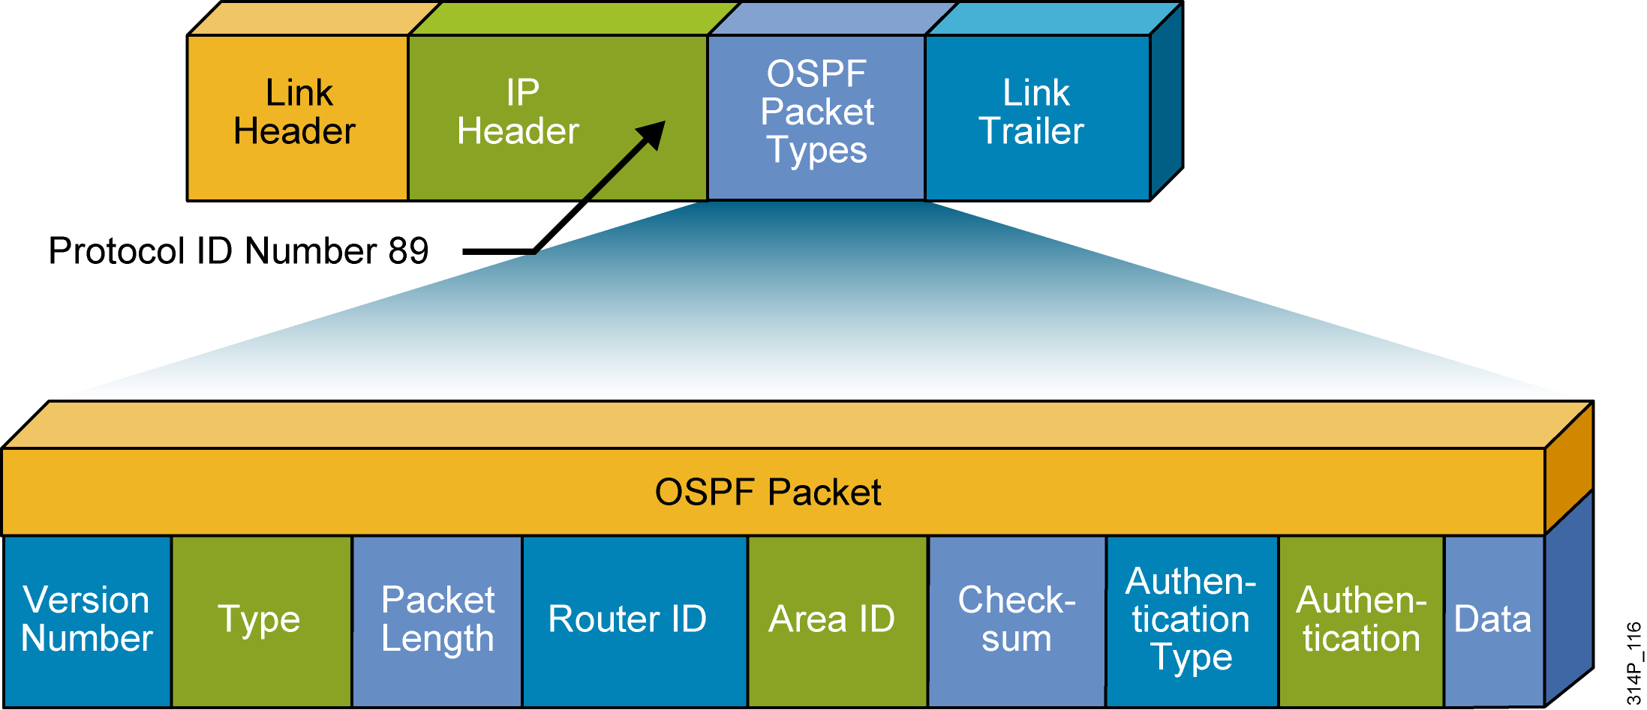
OSPF Packet Header Format
R1#debug ip ospf packet
OSPF packet debugging is on
R1#
*Feb 16 11:03:51.206: OSPF: rcv. v:2 t:1 l:48 rid:10.0.0.12
aid:0.0.0.1 chk:D882 aut:0 auk: from Serial0/0/0.2
This debug output shows fields in the OSPF header.

Slide 4
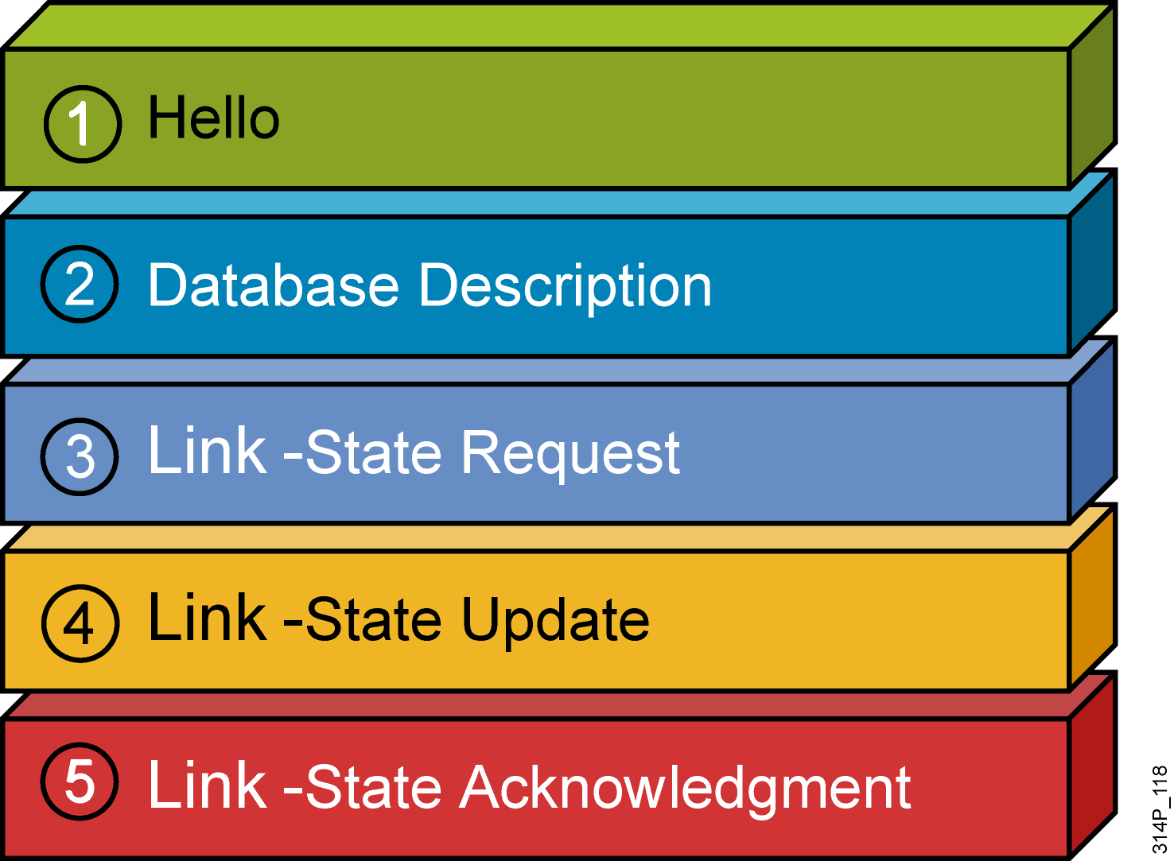
OSPF Packet Types
OSPF uses five types of routing protocol packets.

Slide 5
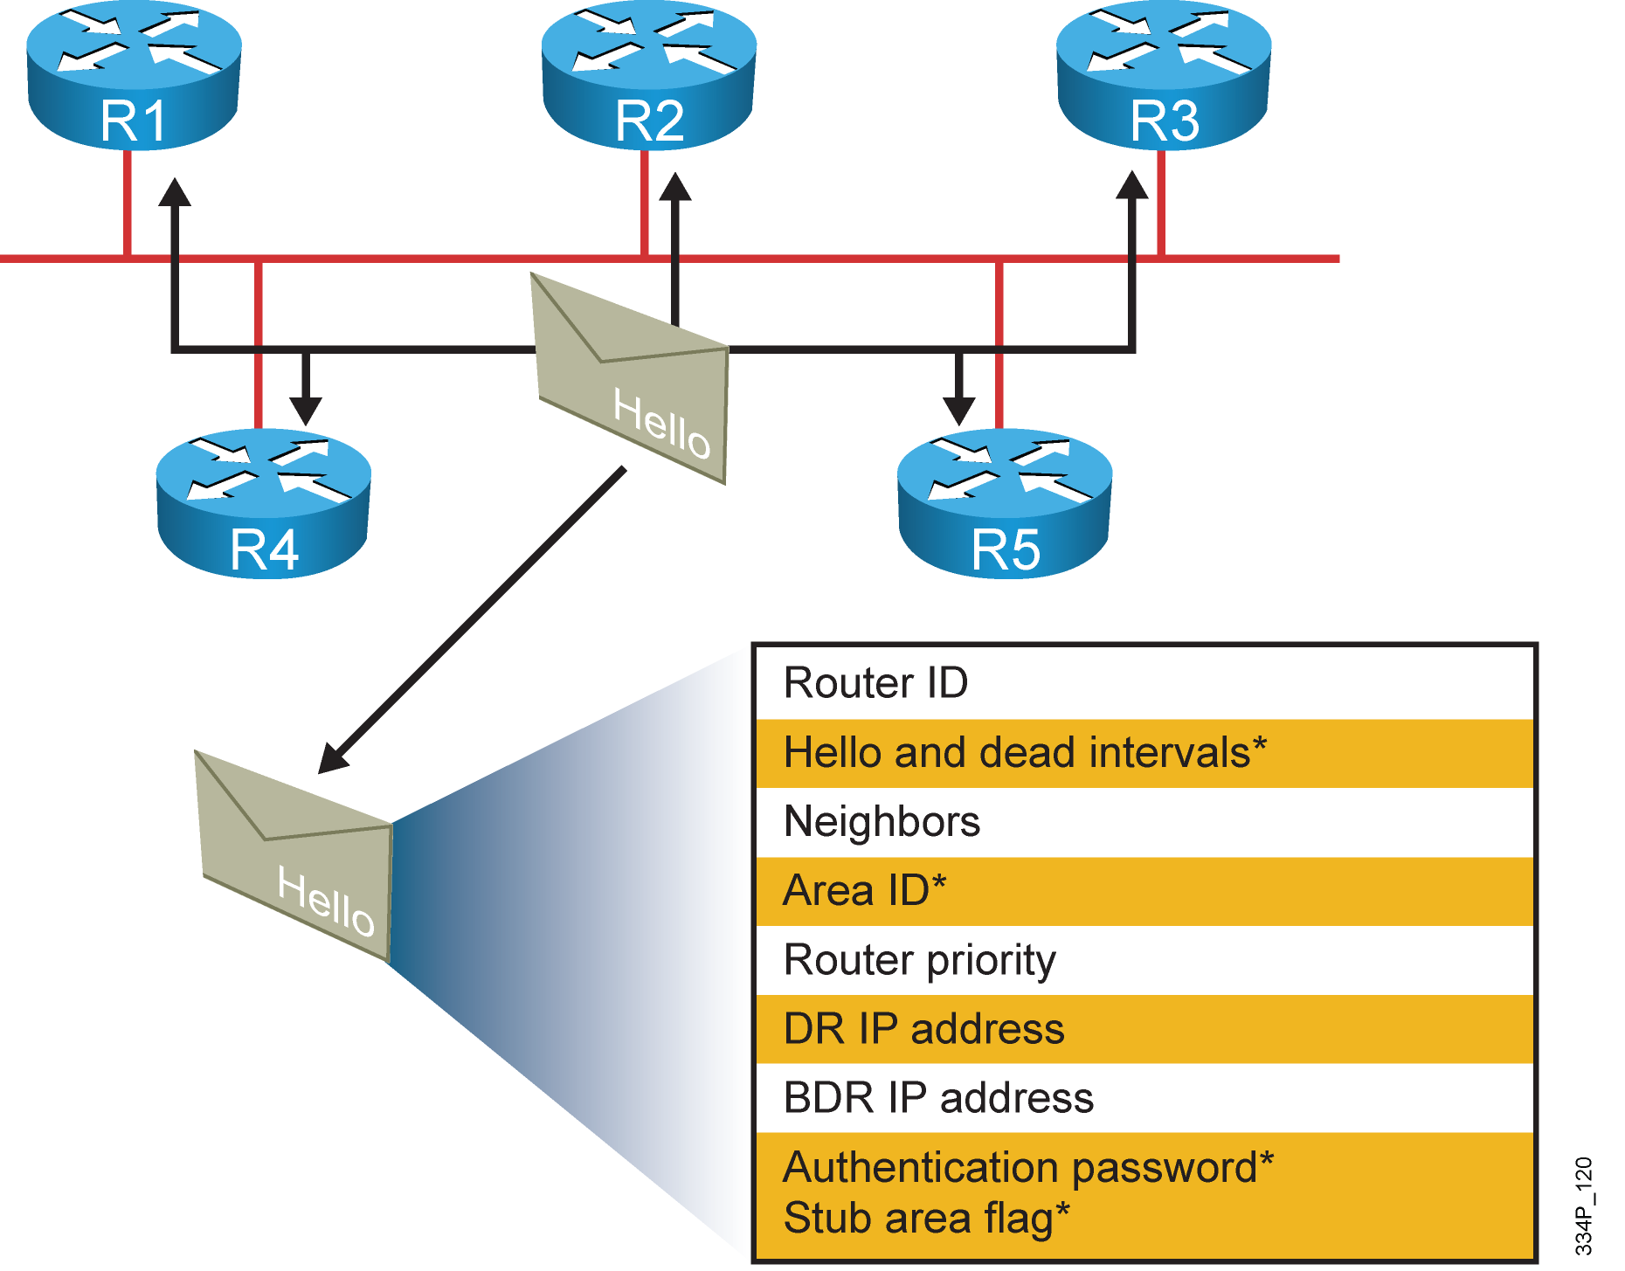
Neighbor Relationship: The Hello Packet
* Entries must match on neighboring routers

Slide 6
OSPF Routing Update Packets
Use of Multicast and unicast IP address
Four types of update packets
LSDB synchronization process
Discover neighbor
Establish bidirectional communication
Elect a designated router, if desired
Form an adjacency
Discover the network routes
Update and synchronize link-state databases

Slide 7
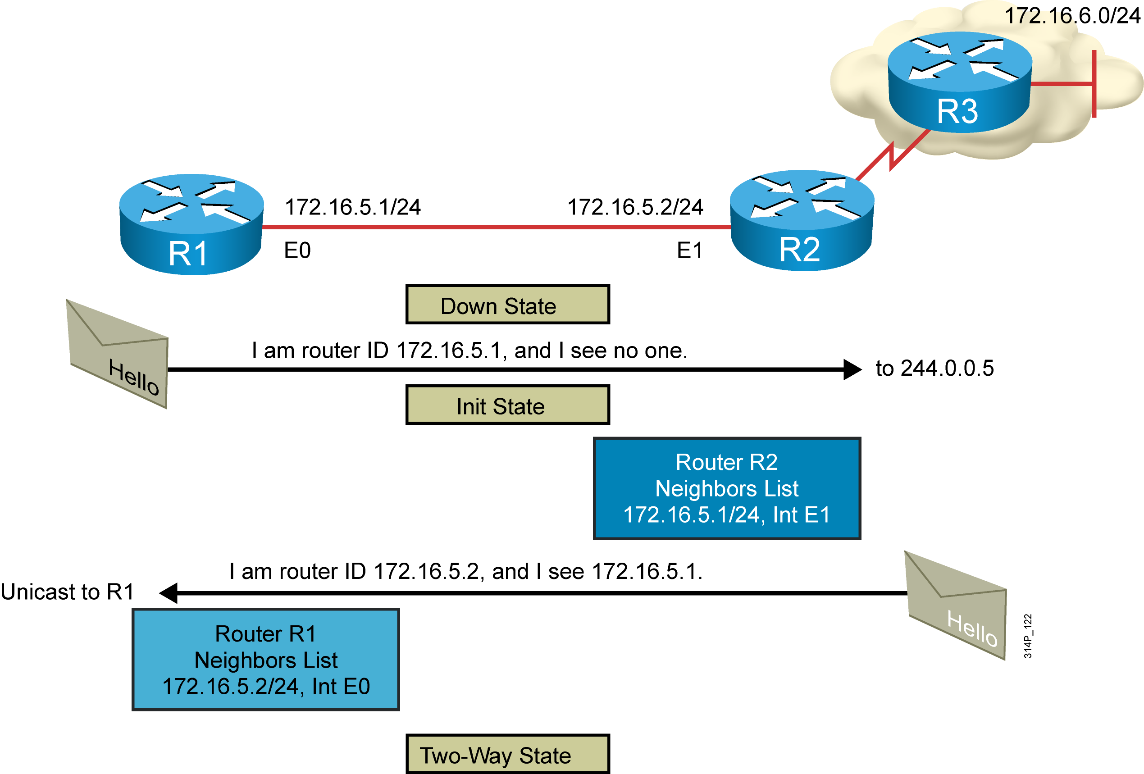
Establishing Bidirectional Communication

Slide 8
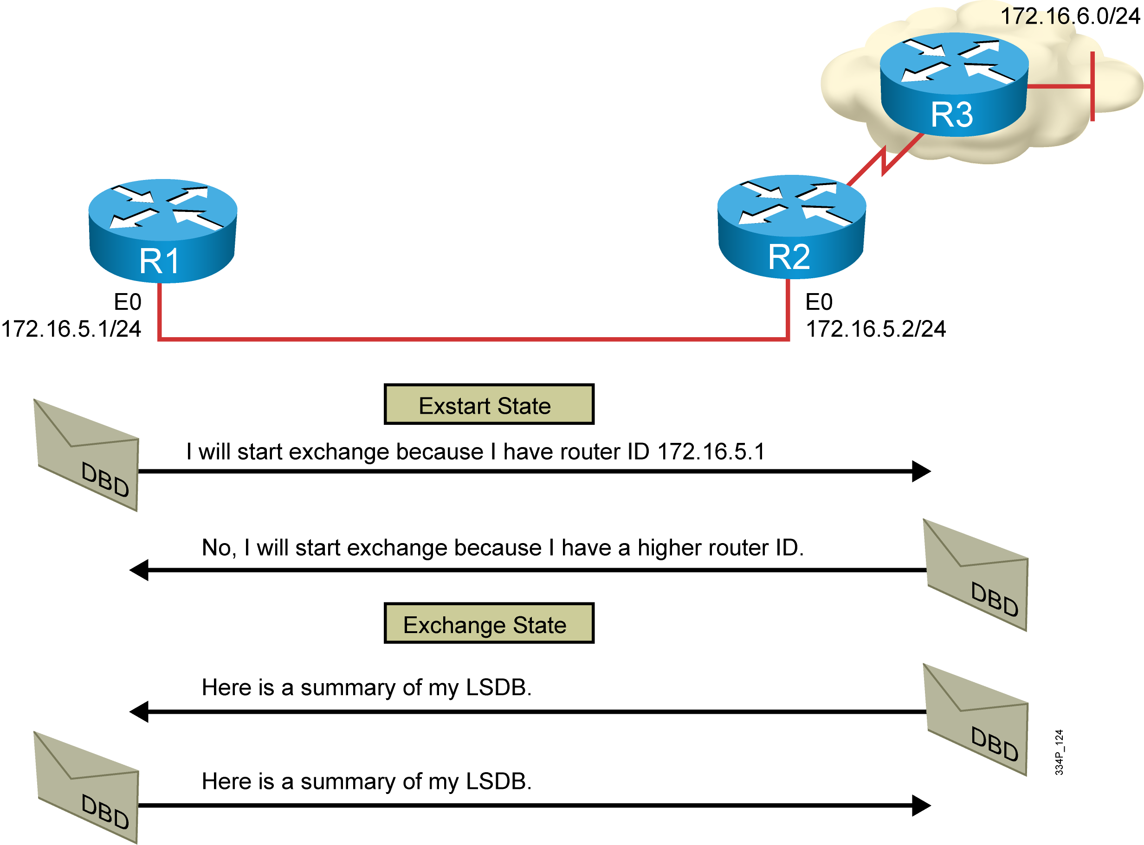
Discovering the Network Routes

Slide 9
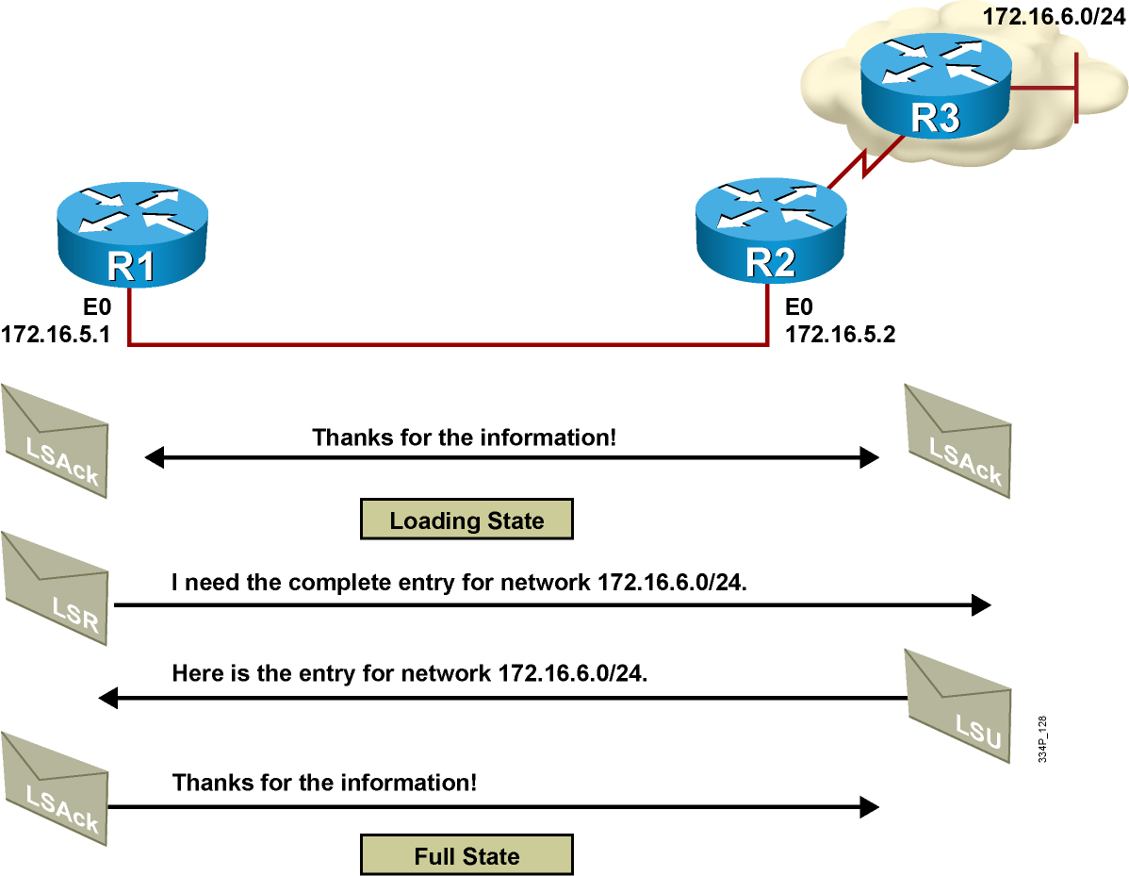
Adding the Link-State Entries

Slide 10
OSPF Neighbor States
OSPF routers progress through seven states:
Down: no active neighbor detected
INIT: hello packet received
Two-way: own router ID in received hello
Exstart: master and slave roles determined
Exchange: database description packets sent
Loading: exchange of LSRs and LSUs
Full: neighbors fully adjacent

Slide 11
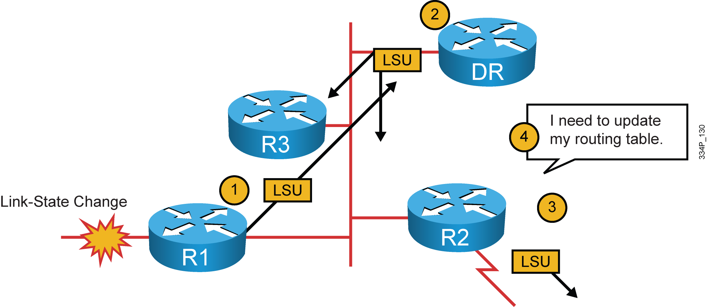
Flooding Changes in Topology
Router R1 that detects a topology change adjusts its LSA and floods the LSA:
Router R1 notifies all OSPF neighbors using 224.0.0.5, or, on LAN links, all OSPF DRs and BDRs using 224.0.0.6.
The DR notifies others on 224.0.0.5.
The LSDBs of all routers must be synchronized.

Slide 12
The debug ip ospf packet Command
Debugging a single packet
This debug output shows the fields in the OSPF header.
R1#debug ip ospf packet
OSPF packet debugging is on
R1#
*Feb 16 11:03:51.206: OSPF: rcv. v:2 t:1 l:48 rid:10.0.0.12
aid:0.0.0.1 chk:D882 aut:0 auk: from Serial0/0/0.2

Slide 13
Summary
There are five OSPF packet types: hello, DBD, LSU, LSR, and LSAck.
The Hello protocol forms logical neighbor adjacency relationships. A DR may be required to coordinate adjacency formations.
The exchange protocol passes through several states (down, INIT, two-way, exstart, exchange, and loading) before finally reaching the goal of the full state. When the protocol is in the full state, its databases are synchronized with adjacent routers.
LSAs are sent when a change occurs, but are also sent every 30 minutes to ensure database integrity. The maximum time that an LSA will stay in the database, without an update, is 1 hour.
Use the debug ip ospf packet command to verify that OSPF packets are flowing properly between two routers.

